Slide 1
CGB1201 – JAVA PROGRAMMING
Department of Artificial Intelligence and Data Science
Academic Year: 2024 – 2025 (Odd Semester)
Register Number : 2303811724322118
Name : VAISHALI A
Year : IInd YEAR
Semester : III
Section : B
Date : 03/12/24

Slide 2
Title of the Project
PASSWORD GENERATOR

Slide 3
Problem Identification
Create complex, secure passwords with a mix of uppercase, lowercase, numbers, and special characters.
Allow users to specify password length and include/exclude character types based on preferences.
Use Java's Secure Random to ensure passwords are unpredictable and meet security standards.

Slide 4
Objective
The objective of this project is to design and implement a password generator in Java that produces strong, secure, and customizable passwords. The generator should offer flexibility in terms of password length, character types (uppercase, lowercase, numbers, and special characters), and ensure compliance with current security standards. It will utilize cryptographically secure randomization techniques to guarantee the unpredictability and strength of the generated passwords, ultimately enhancing user security and reducing the risk of unauthorized access.

Slide 5
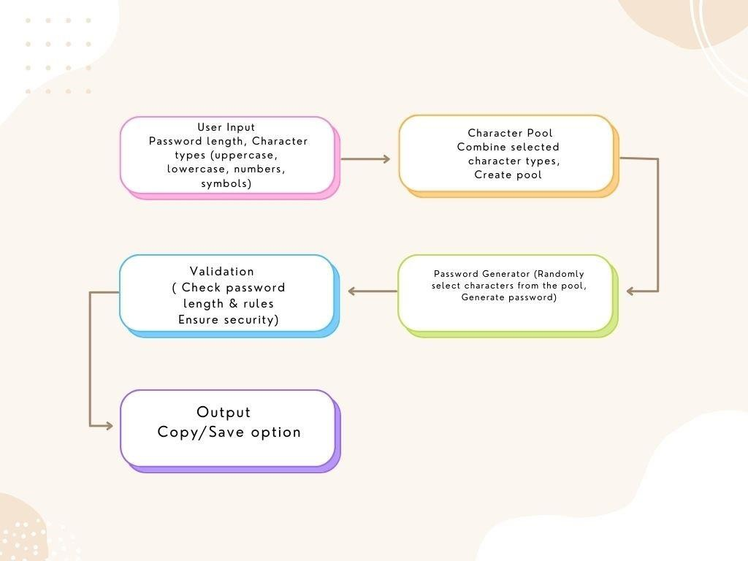
Proposed Architecture

Slide 6
Java Programming - Concepts Used
Object-Oriented Programming (oops):
Encapsulation: Organizing the password generator logic within dedicated classes.
Randomization:
Use of the Secure Random class for generating cryptographically secure random values.
String Manipulation:
Use of String Builder for constructing passwords efficiently. Handling character sets using arrays and lists for inclusion/exclusion.
Control Structures:
Loops to iterate through user-defined password length.
Conditional Statements to include specific character types based on user input.

Slide 7
List of Modules
1.Input Module
2.Character Pool Module
3Password Generation Module
4.Validation Module
5.Output Module

Slide 8
Module Description
Input Module
Takes input for password length and character types (uppercase, lowercase, numbers, symbols).
Character Pool Module
Creates a list of available characters based on the user’s selected options.
Password Generator Module
Randomly selects characters from the pool to create a password.
Validation Module
Ensures the password meets basic security standards (e.g., length, character diversity).
Output Module
Displays the generated password and allows it to be copied or saved.

Slide 9
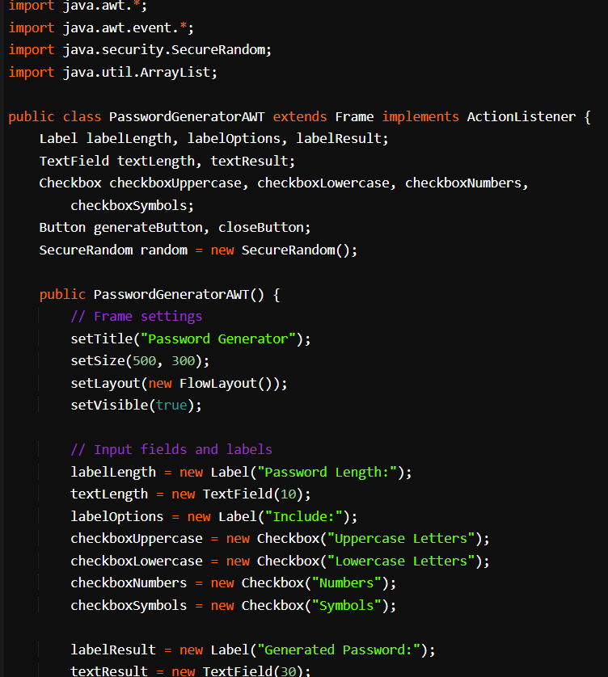
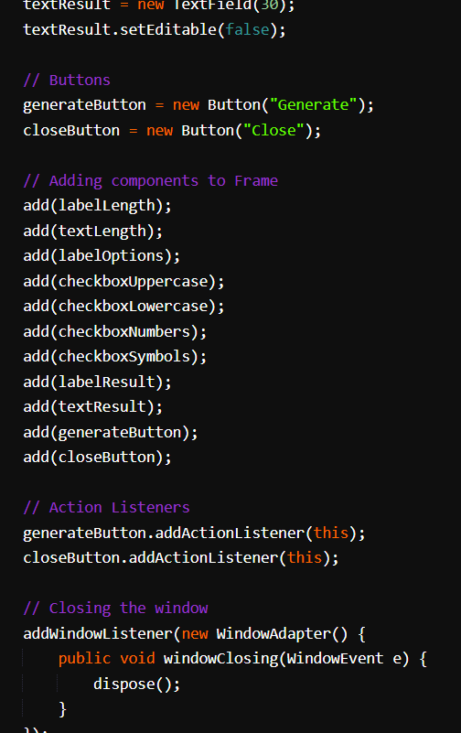
Source Code

Slide 10
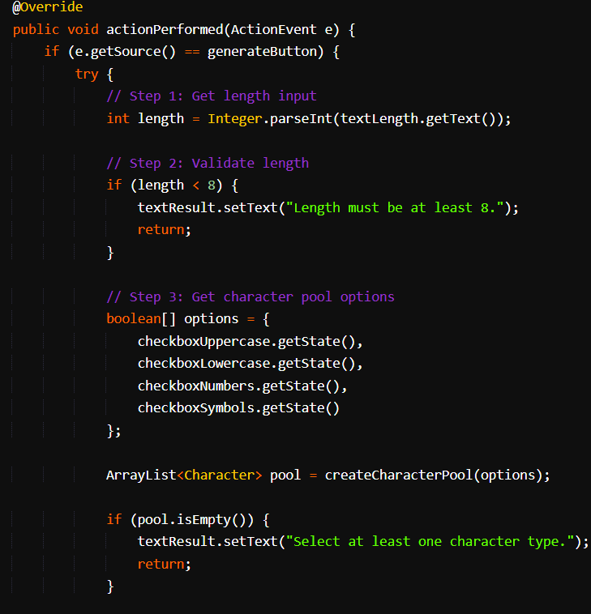
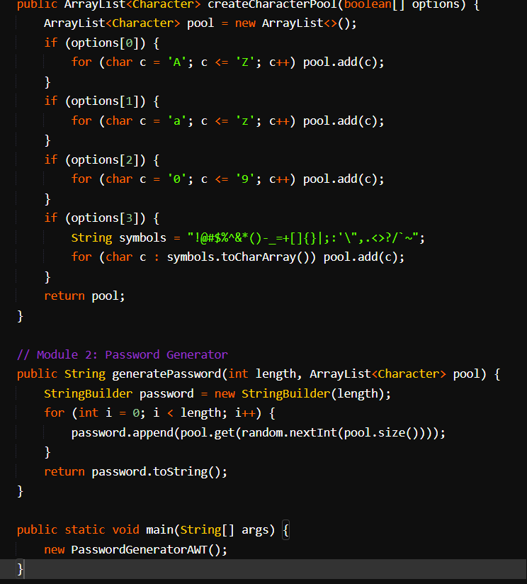
Source Code

Slide 11
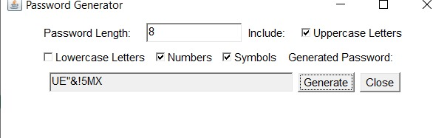
Results and Discussion

Slide 12
Conclusion
The Password Generator application provides a secure way to create strong passwords, fulfilling the need for enhanced online security. By using user-defined criteria and adhering to security standards, it mitigates the risks associated with weak passwords. The modular approach ensures scalability and ease of maintenance.

Slide 13
Thank You

